Slide 1
BDFS-Brute Force stream mining
IIM-A
by SUJEET

Slide 2
Outline
What is a data stream ?
Applications of data stream management
Difference between traditional and stream mining

Slide 3
What is a data stream ?
Golab & Oszu (2003):Golab & Oszu (2003): “A data stream is a real-time, continuous, ordered (implicitly by arrival time or explicitly by timestamp) sequence of items. It is impossible to control the order in which items arrive, nor is it feasible to locally store a stream in its entirety.”
Massive volumes of data, records arrive at a high rate: The example of Web TCP :
Timestamp | Source | Destination | Duration | Bytes | Protocol
… | … | … | … | … | …
12342 | 10.1.0.2 | 16.2.3.7 | 12 | 20K | http
12343 | 18.6.7.1 | 12.4.0.3 | 16 | 24K | http
12344 | 12.4.3.8 | 14.8.7.4 | 26 | 58K | http
12345 | 19.7.1.2 | 16.5.5.8 | 18 | 80K | ftp
… | … | … | … | … | …

Slide 4
Data Streams
Continuous flow of data generated at high-speed in
Dynamic, Time-changing environments.
The usual approaches for querying, clustering and prediction
use batch procedures cannot cope with this streaming setting.
We need to maintain Decision models in real time.
Decision Models must be capable of:
incorporating new information at the speed data arrives;
forgetting outdated information;
detecting changes and adapting the decision models to
the most recent information.

Slide 5
The Data Stream Phenomenon
Highly detailed, automatic, rapid data feeds.
Radar: meteorological observations.
Satellite: geodetics, radiation,.
Astronomical surveys: optical, radio,.
Internet: traffic logs, user queries, email, financial,
Sensor networks: many more observation points ...
Most of these data will never be seen by a human!
Need for near-real time analysis of data feeds.
Monitoring, intrusion, anomalous activity, classification,
prediction, complex correlations, detect outliers, extreme
events, fraud, ....

Slide 6
Applications of data stream processing
Data stream processing
Process queries (compute statistics, activate alarms)
Apply data mining algorithms
Real-time processing
One-pass processing
Bounded storage (no complete storage of streams)
Possibly consider several streams

Slide 7
Applications of data stream processing
Applications
Real-time monitoring/supervision of IS (Information Systems) generating large amounts of data
Computer network management
Telecommunication calls analysis (BI)
Internet applications (ebay, google, recommendation systems, click stream analysis)
Monitoring of power plants
Generic software for applications where basic data is streaming data
Finance (fraud detection, stock market information)
Sensor networks (environment, road traffic, weather forecast, electric power consumption)

Slide 8
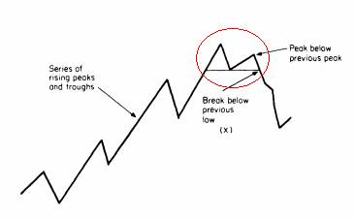
Applications of data stream processing
Stock monitoring
Stream of price and sales volume of stocks over time
Technical analysis/charting for stock investors
Support trading decisions

Slide 9
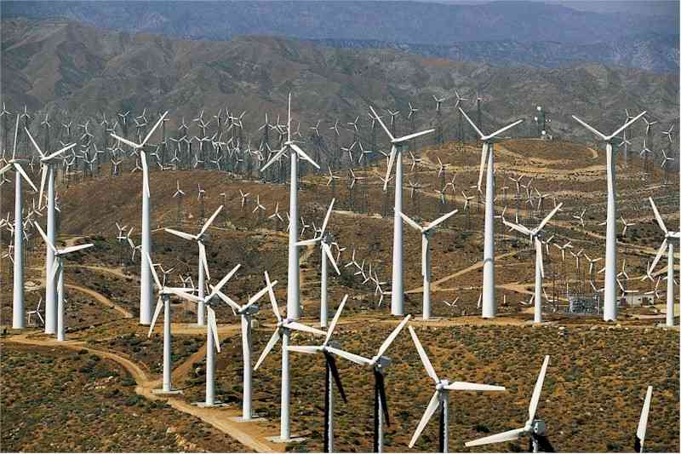
Applications of data stream processing
The ability to predict locations of windmills , and directions of wind in early time ,can help to produce large amount of energy compared to current power obtained.
The stream mining is liable here as we need to gather information from the wind in real time and predict the wind's direction in a approximate but early time.

Slide 10
Difference between traditional and stream mining
 | Standard data processing technology | Data stream processing technology
Monitoring, Business Intelligence applications | Data warehouses (unscalable) | Querying and mining ‘on the fly’ (scalable)
Applications with basic streaming data | Specific development without database technology | Generic tools for processing data

Slide 11
Difference between traditional and stream mining
Difference between traditional and stream data mining techniques:
1)In stream mining we have only one look over the data , in traditional we can have mine it several times, as data is stored.
2)Processing time in stream mining is restricted , the current query has be processed before the arrival of next one.
3)Memory is limited, so entire data stream is not stored and a summary is derived from the data
4)In stream mining data is usually distributed as compared to traditional data mining, where it is usually centralized.

Slide 12
Association Rule
We present association rule taking to account of Agarwal et al, 1993 X=>Y (Y implies X) is examined,
The support of the rule, is the fraction of the total transactions that contain all items
both in X and Y.
For association mining :support and confidence should satisfy a minimum support and confidence level that will be specified by the user.
Association mining can be decomposed in two phases:
1)Frequent item generation :Its compares any itemset's support with the minimum support specified , if more than item is termed as frequent.
2)Rules construction: From the frequent itemsets generated, generate all confidence rule that which is higher than the given minimum confidence.

Slide 13
Extracting from association mining
The need to break traditional “collect-store-analyze” model makes is essential for large datasets which require fast processing. BDFS(b) overcomes such shortcomings.
BDFS(b) :brute force Block Depth First Search,
Real-time frequent pattern mining algorithm,
Runs under limited computer memory.

Slide 14
Need for real time calculation
Study of CRM(customer relation management) plays a major role in any customer oriented business
Notice that retaining current customer business is more economical than finding new one, so mining customer's behaviour is a prerequisite. Therefore to understand and satisfy current customers is very beneficial.
Thus hidden patterns and trends in customer’s behavior in past to predict customer’s behavior at a given situation in future.
The information can be extracted from analyzing web clicks of the particular user or sales presentations according to earlier interactions and matching them with the past purchasing.
Similarly recommender systems are used for predicting that a particular user would like a particular item and what are its chances to be bought by the customer
Such approaches where preferences are built and very old data that is used is not very useful for the scenario (used by recommender system) as a need for instant fresh data is required.

Slide 15
Need for real time calculation
Building data over time and evaluating it for future decisions are used but fluctuations cannot be handled , so not dynamic.
Real time analysis is required at places like
real-time enterprise risk and vulnerability management
real-time stock management and vendor inventory
real-time operational management with special applications in mission critical real-time information as is used in the airlines industry,
real-time intrusion
real-time fraud detection
real-time negotiations and
other areas like real-time dynamic pricing and discount offering to customers in real-time

Slide 16
Earlier Works
Association rule mining has introduced by Hajek et al and by Agrawal et al.
The need for finding frequent itemsets is essential in making the summary structure from the stream
Still the total search space for the frequent itemset is huge and several solutions have been proposed to perform a more directed search by iteratively generating and counting sets of candidate itemsets.
Apriori algorithm is good but requires k scan of database if longest frequent itemset is of k length.
The algorithms have been classified in terms of their strategy of traversing the search space and their strategy to determine the support values of the itemsets traverse the search space and determine support values of itemset
Then counting strategy, search direction and search strategy. were focussed on as the classifying criteria.
Horizontal counting or vertical intersections are used for counting the occurrences of candidate itemsets
search strategy: bottom up. While applying the search strategy :DFS or BFS was used

Slide 17
Classification of prevailing algorithms
Counting Strategy | Search Direction
 | Bottom-up |  | Top-Down
 | Search Strategy |  | Search Strategy
 | Depth first | Breadth first | Depth first | Breadthfirst
Counting | FP-Growth | Apriori |  | Top-Down
Intersection | ECLAT | Partition

Slide 18
BDFS(b): An Efficient Technique of Frequent Pattern Mining in Real-Time
A brute force algorithm is proposed , which is a variant of the Block Depth First Search
The given search space explores in stages
The DFS approach prefers pattern of greater length over shorter ones.
A lower triangular matrix is formed as an intialization which stores the support independent frequencies of all 1-length and 2-length patterns
The F(1) and F(2), which denotes frequent itemsets of length 1 and 2, are used to build the further frequent itemsets .
Features of BDFS(b)
It conducts search in stages and uses backtracking strategy to run to completion and ensure optimal solution.
Takes block, checks for frequent patterns and generates patterns of next higher length.

Slide 19
BDFS(b)
Count support freq of all candidate patterns from database.
Generate the borders set(or candidate pattern) of next higher level.
Arrange by merits and put in b-size blocks.. if block is empty, it gets patterns from previous level handled by global pool of candidate patterns sorted in decending order of length.
Root node: initial search space:S0 contain complete set of F(2)

Slide 20
Algorithm
Expansion of a node
Count support freq of all candidate patterns from database.
Generate the borders set(or candidate pattern) of next higher level.
Arrange by merits and put in b-size blocks.. if block is empty, it gets patterns from previous level handled by global pool of candidate patterns sorted in descending order of length.

Slide 21
Algorithm
Initialization
Initialize the allowable execution time τ(so that the algorithm doesn’t run forever).
Let the initial search frontier contain all 3-length candidate patterns. Let this search frontier be stored as a global pool of candidate patterns.
Initialize a set called Border Set to null.
Order the candidate patterns of the global pool according to their decreasing length (we can resolve ties arbitrary, but for convention sake, say it is alphabetically arranged)
Take a group of most promising candidate patterns and put them in a block b of predefined size.

Slide 22
Algorithm
Expand (b)
Expand (b: block of candidate patterns)
If not last_level then
begin
Expand1(b)
end.

Slide 23
Algorithm
Expand1(b):
1. Count support for each candidate pattern in the block b by intersecting
the t-id list of the items in the database.
2. When a pattern becomes frequent, remove it from the block b and put it in the list of frequent patterns along with its support value. If the pattern is present in the Border Set increase its subitemset counter. If the subitemset counter of the pattern in Border Set is equal to its length
move it to the global pool of candidate patterns.
3. Prune all patterns whose support values < given minimum support.
Remove all supersets of these patterns from Border Set.

Slide 24
Algorithm
4.Generate all patterns of next higher length from the newly obtained
frequent patterns at step 3. If all immediate subsets of the newly
generated pattern are frequent then put the pattern in the global pool of
candidate patterns else put it in the Border Set if the pattern length is >3
5. Take a block of most promising b candidate patterns from the global
pool.
6. If block b is empty and no more candidate patterns left, output frequent
patterns and exit.
7. Call Expand(b) if enough time is left in τ to expand a new block of
patterns, else output frequent patterns and exit.

Slide 25
Explanation
We take an example to implement the BDFS(b)
1. a b c d e d | 2. a c d e | 3. a d e | 4. b c d e
5. b d e | 6. a b d | 7. a b d | 8. a b c
9. d e | 10. a c d e | 11. a b c d e | 12. ace

Slide 26
Explanation
The structure of the lower triangular matrix M is shown with F(1) and F(2) being shown which represents the frequency of itemsets as
 | a | b | c | d | e
a | 9
b | 5 | 7
c | 6 | 4 | 7
d | 8 | 7 | 6 | 11
e | 6 | 4 | 6 | 8 | 9

Slide 27
Explanation
The matrix M has a total size of n(n+1)/2
In M, M(i,j) represents the number of occurrences of the item-pair i and j, ∀i = 1,2…n and ∀j = 1,2,3…i
Cells of Matrix M are visited to find F(1) and F(2) in O(1)
F(1) = { a(9), b(7), c(7), d(11), e(9)} ……. (1)
F(2) = { ab(5), ac(6), ad(8), ae(6), bc(4), bd(7), be(4), cd(6), ce(6), de(8)} ……………………………………………… (2)
Two 2-length patterns are merged if their first elements match as:
{ abc, abd, abe, acd, ace, ade, bcd, bce, bde, cde } …………… (3)

Slide 28
Explanation
Find frequent patterns in these from the patterns present in the transactions
If the newly found subset doesn’t have all its subset present, then it is pruned.
if all its 2-length subsets are present the pattern becomes a candidate-pattern and it is moved to the global-pool of candidate patterns C( ).
Here, C ( ) = { abc, abd, abe, acd, ace, ade, bcd, bce, bde, cde} …. (4)

Slide 29
Explanation
The block size is specified by user which is used as a parameter in code, we define it to be 4 here, but normally it is much larger in real world scenario.
We now check the frequency of these patterns by intersecting the tid-lists of the items. b = {abc (3), abd (5), abe (2), acd (5)} .......... (5)
As frequency of abe is less than the support threshold, it gets pruned as from the table of transaction the support value of abe is less the minimum support :2
F (3) = {abc (3), abd (5), acd (5)} ………… (6) forms the frequent itemsets with length of 3.
Eventually the border element formed by the merging length-4 element :F(4)=BS(4)={abcd(3)}
Similarly the nest batches in form :b={ace(5),ade(5),bcd(4),bce(3)}.................. (9)

Slide 30
Explanation
Finally we obtain the frequency list as :
F(1) = { a(9), b(7), c(7), d(11), e(9)}
F(2) = { ab(5), ac(6), ad(8), ae(6), bc(4), bd(7), be(4),
cd(6), ce(6), de(8)}
F(3) = { abc (3), abd (5), acd (5), ace(5) ,ade(5), bcd(4),
bce(3), bde (3),cde (5)}
F(4) = { abcd (3), acde (4), bcde (3)}

Slide 31
Analysis of Results
T= Average size of transaction;
I= Average size of the maximal potentially large itemset;
D= No. of transactions in the database;
N= Number of items.
Comparisons were made between FP growth and BDFS(b) using IBM data synthesis generator using real time datasets like BMS-WebView-1 and several synthetic datasets like: T10I8D100K, T10I8D10K, T10I8D1K, T10I2D100K, T6I5D10K, T5I4D1K, T5I4D10K,T5I4D100K

Slide 32
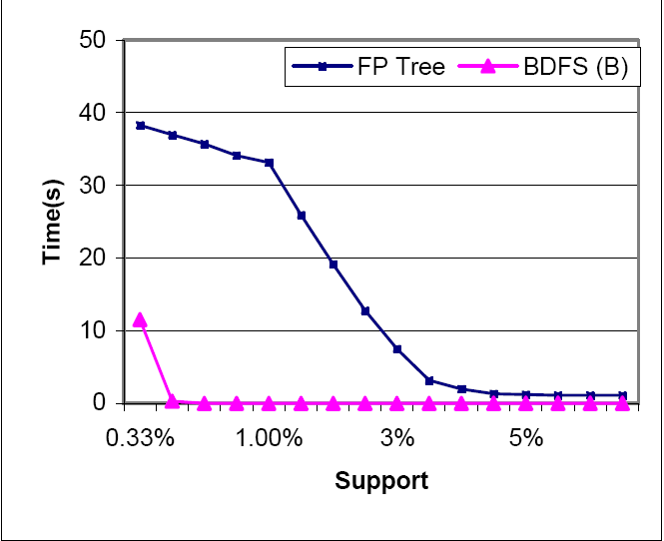
Analysis of Results
Time Comparison of FP-growth and BDFS(b) T10I8D100K,B=100K

Slide 33
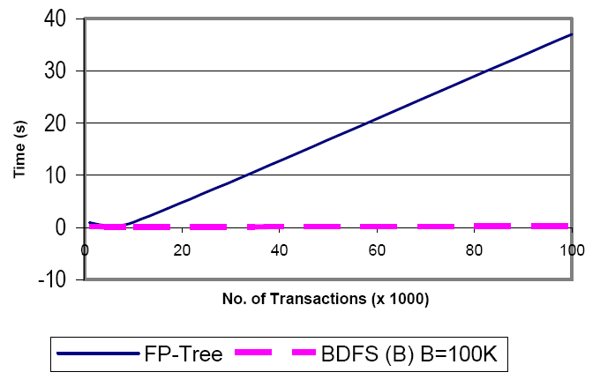
Analysis of Results

Slide 34
THANK YOU

